Slide 1

Predicting Market Value of FIFA Soccer Players
Carrie Liu 5/6/2022

Slide 2
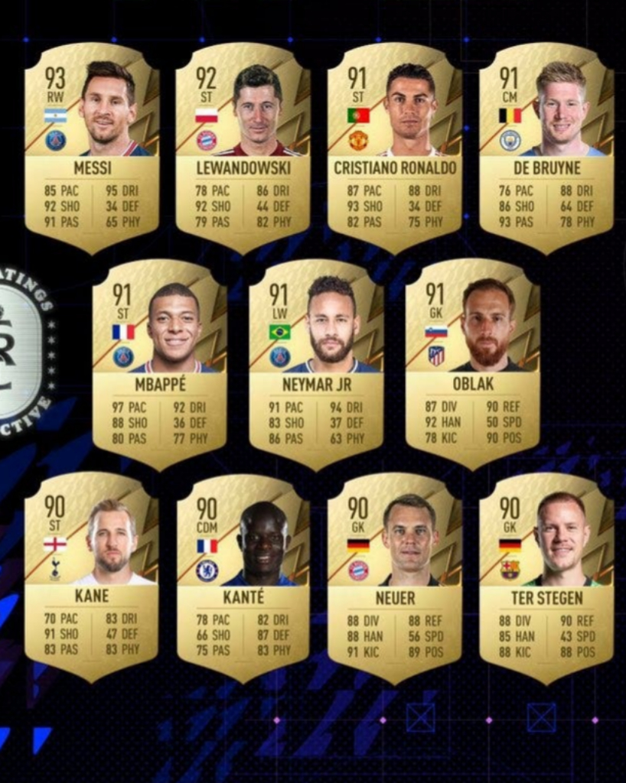
Overview
EA sports will reveal its FIFA ratings for each soccer player every year. From sprint speed to finishing, passing accuracy to stamina, they watch what happens on the pitch to assess, judge and evaluate players across more than 30 attributes that define a player’s skill level. We will leverage the datasets of FIFA Ratings to predict the market value of FIFA soccer players.

Slide 3
Our Approach
Data Source Kaggle FIFA 22 complete player dataset, with 100+ attributes for the Career Mode
Objective Predicting the Market Value of soccer players and understand what key factors determine their Market Value
Approach Building regression models with Linear Regression and Machine Learning Regressors to get the best prediction of the Market Value of soccer players; Leveraging Feature Importance to understand the key attributes

Slide 4
Linear Regression
From our selected Linear Regression Model, the most important features (except nationality-related features which also matter) that determine the market value of the soccer players are:
Body type is Unique
Club position is Attacking Midfielder (Right, Left and Center as ranked in order)
High international reputation
Adjusted R² | 99.3%
RMSE for Train Data | 0.73
RMSE for Test Data | 0.80
Note: RMSE stands for Root Mean Squared Error

Slide 5
Machine Learning Regression
We have run multiple Machine Learning Regression Models, selected the best model with lowest RMSE for test data and tuned the selected model with GridSearchCV to obtain best prediction results:
Decision Tree Regressor
Random Forest Regressor
XGBoost Regressor
Support Vector Regressor
Adjusted R² | 99.2%
RMSE for Train Data | 0.48
RMSE for Test Data | 0.74
Note: RMSE stands for Root Mean Squared Error

Slide 6
Feature Importance
Release Clause on contract and Weekly Wages
Specific physical attributes and skills*
HIGH International Reputation
* Specific physical attributes and skills in top 10 features are movement sprint speed, movement reactions, shooting, unique body type, dribbling, ball control skill and volleys attacking

Slide 7
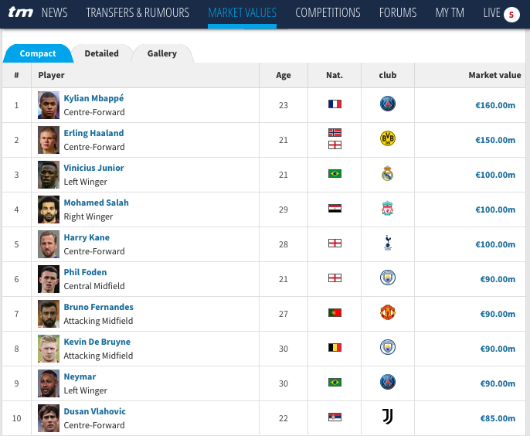
Conclusion
“A player’s Market Value is an estimate of the amount for which a team can sell the player's contract to another team”.*
Data-driven predictions will shed a light into the datasets of soccer players, enabling us to better understand what internal and external factors determine the Market Value of soccer players.
* Herm, Callsen-Bracker, & Kreis, 2014

Slide 8
Next Steps
Improve the parameter selection to tune the regression models
Recategorize the original attributes (e.g., nationality)
Incorporate FIFA ratings into the prediction of Market Value

Slide 9
Thank You

